Slide 1


NFL Scouting Database
By James Coleman
SCIA 340-001
Professor Mida
12/03/2022

Slide 2
Introduction
The purpose of this database design is to implement a secure database environment for an NFL Scouting application. For scouts to successfully recruit the players they want, they need and application that will allow them to evaluate the prospects. The database was created to gather all information about a potential prospect for the upcoming NFL draft. The database was also created to allow the scouts to be able to view and evaluate the prospects information. The database contains the players information, testing results, measurables, offensive stats, and defensive stats. There are records that were inserted into the columns to display how the database works. The users of this database were given roles and privileges to have a separation of roles. The databases that were created will be beneficial for the coaches because of the easy access to the prospects info.

Slide 3
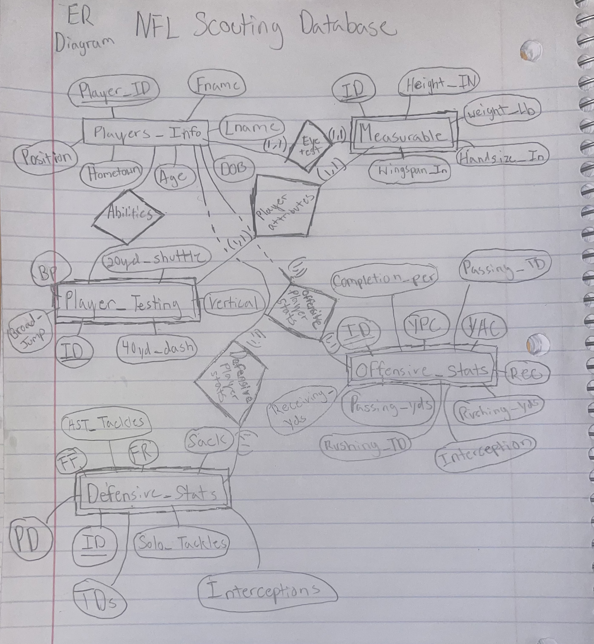
ER Diagram
The NFL Scouting databases contains one strong entity and four weak entities. The strong entity is players info, and it contains attributes that refer the players info. The four weak entities are measurable, player testing, offensive stats, and defensive stats. They are weak entities because they are dependent on the strong entity to refer to them. Also, the weak entity has a foreign key so it can be referred by the strong entity. The weak entities all have a relationship with the strong entity.

Slide 4
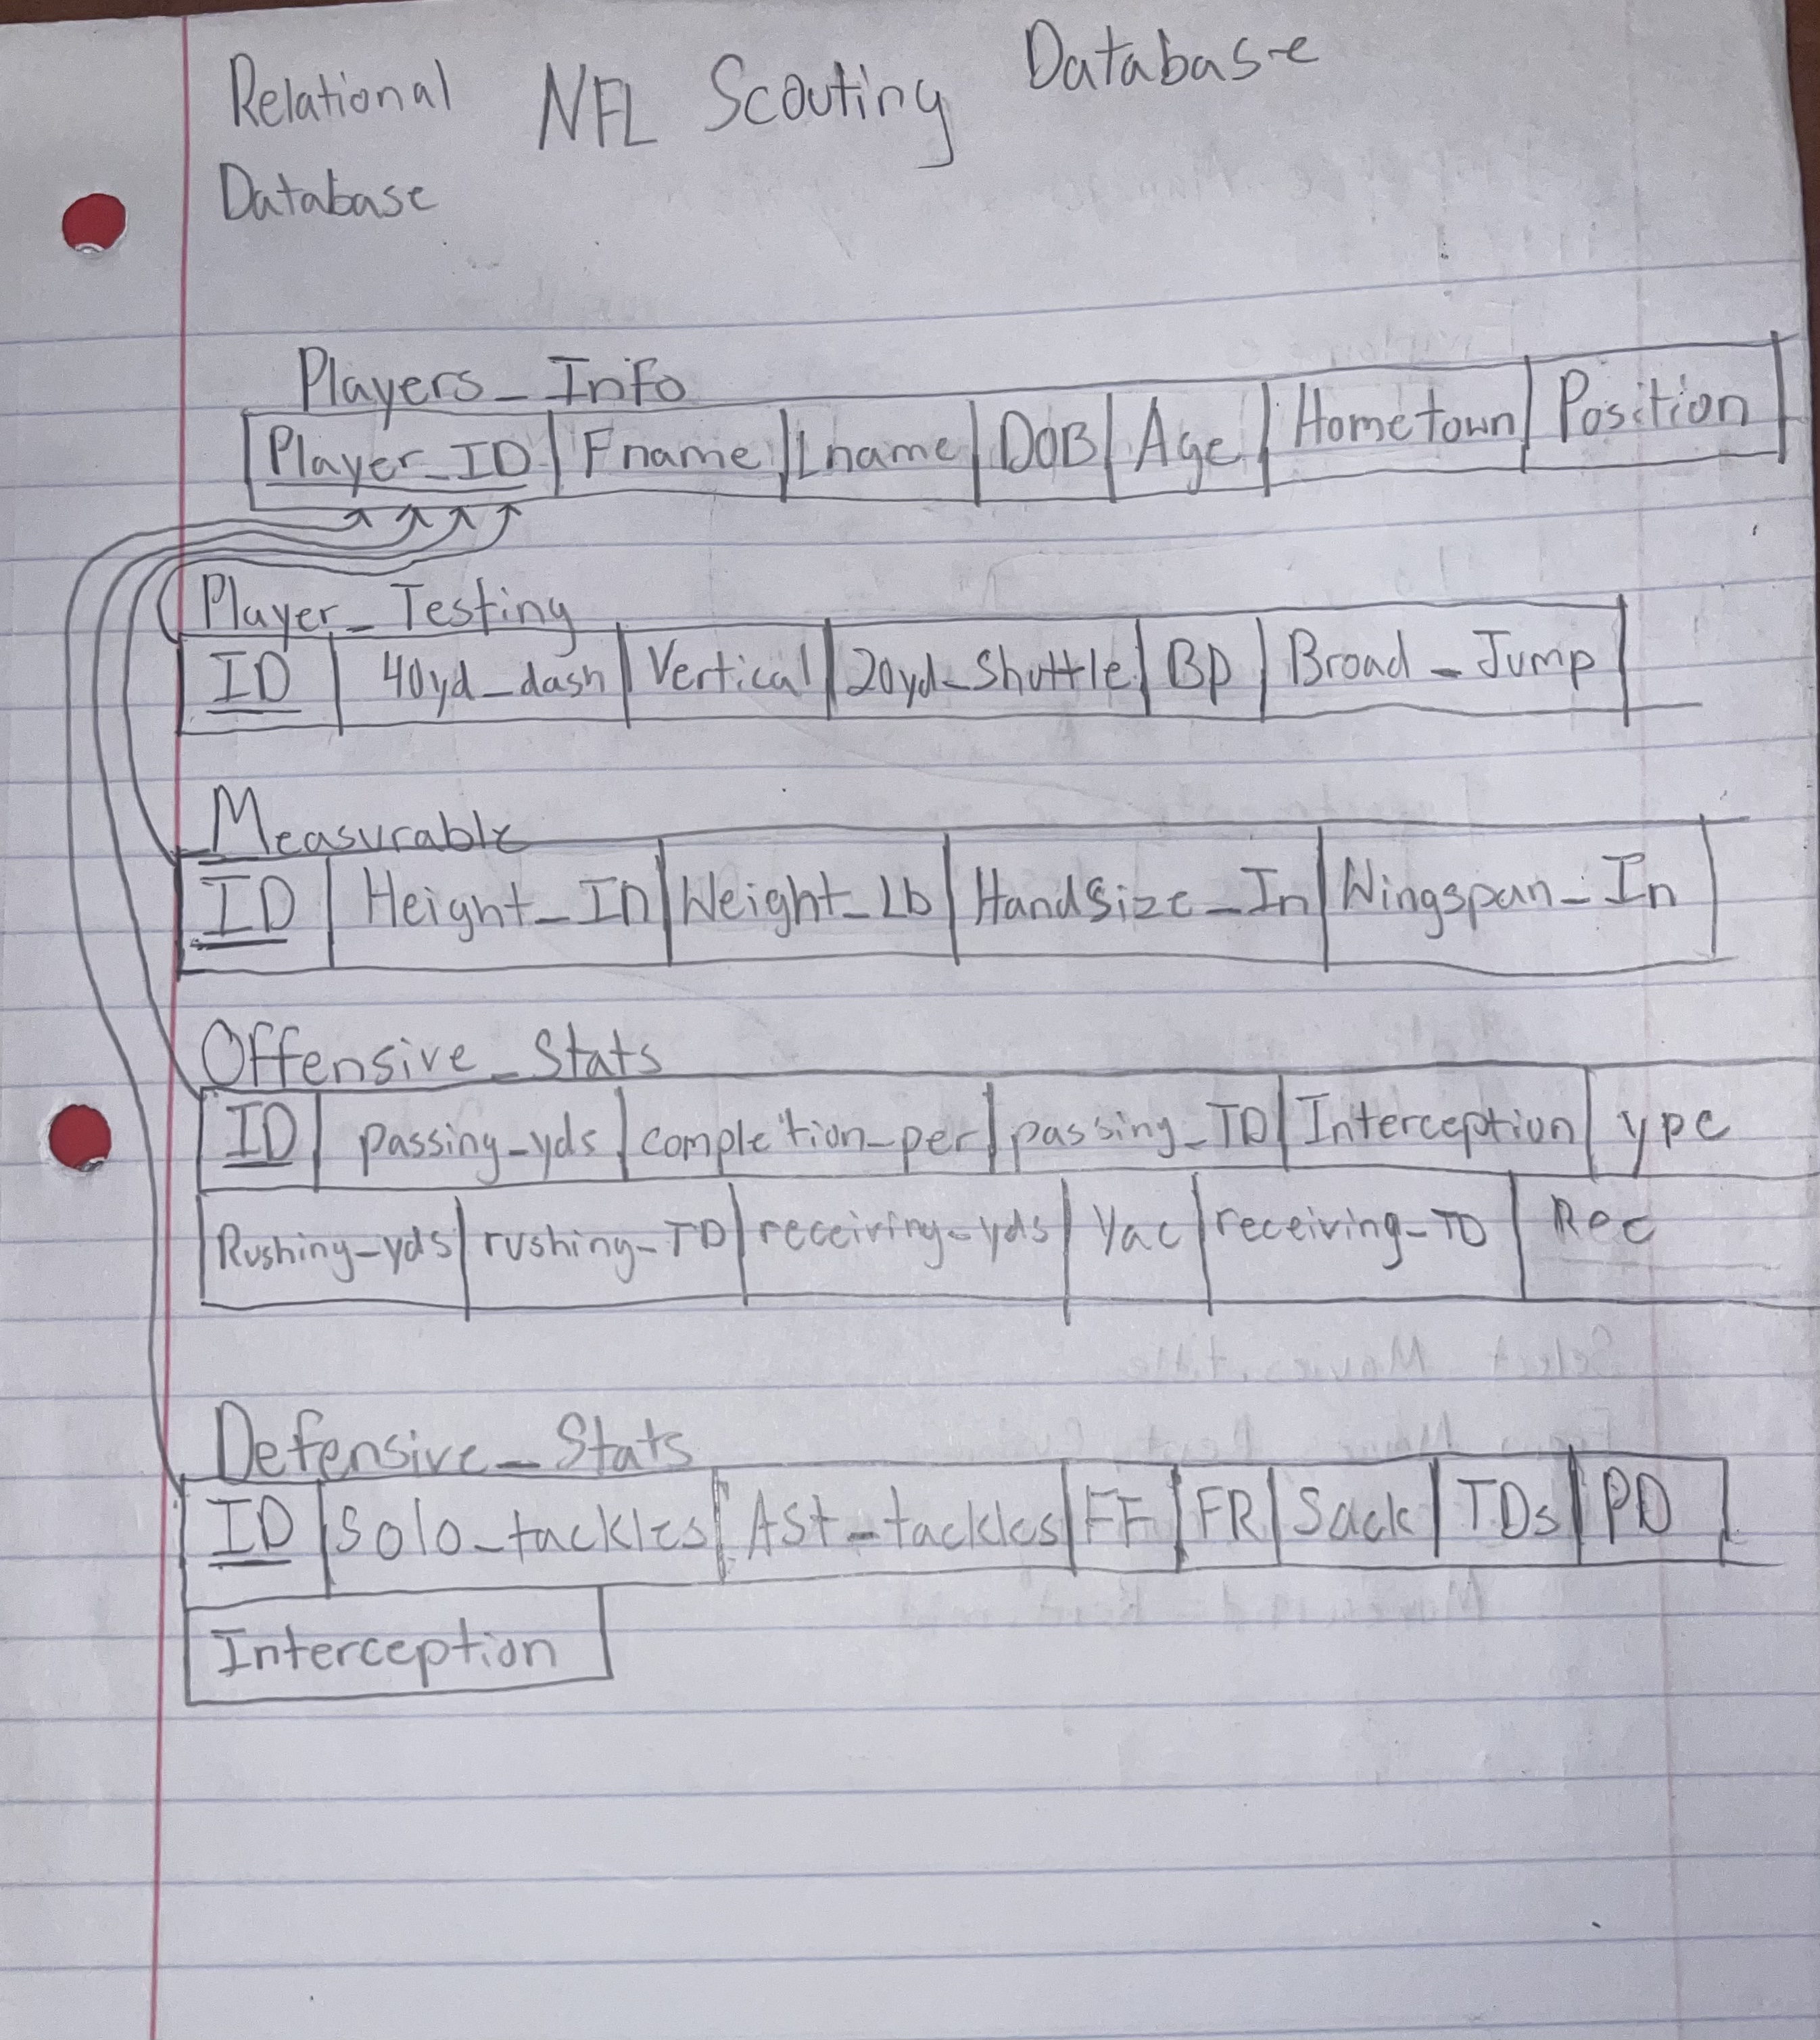
Relational Database Schema
In the relational database schema, it has five different relations. The five relations are players info, player testing, measurable, offensive stats, and defensive stats. The five relations have multiple tuples that are related to the relation. The primary info relation use entity integrity that has a primary key for each relation schema. The four other relations use referential integrity that has a foreign key that is used to relate to the primary key.

Slide 5
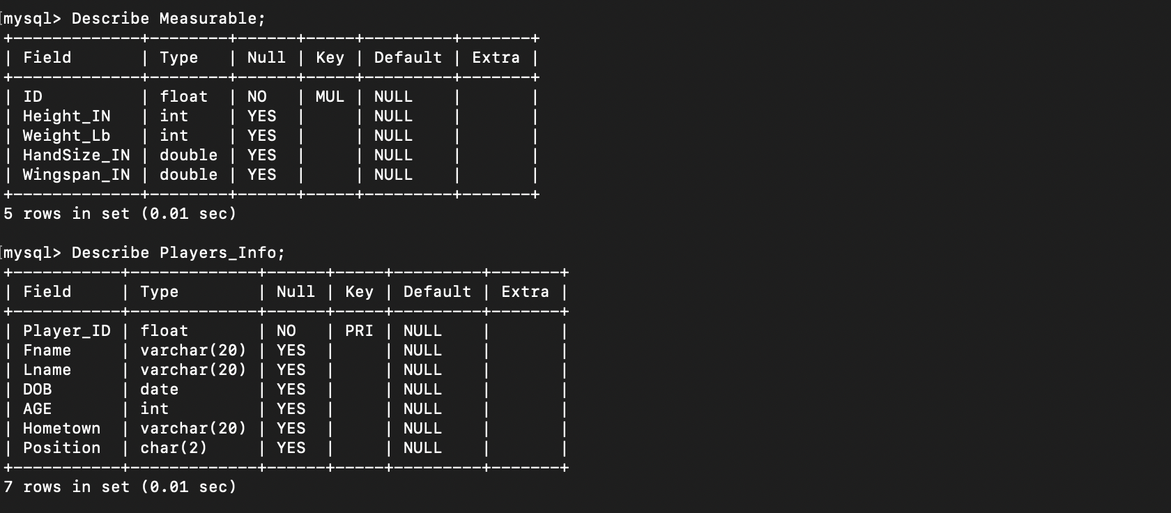
Table Info
Describe table name;
Create Table (Field name, type);
Create Table (Field name, type, not null, Primary key).
Alter Table tablename Foreign Key (ID) References Players Info(Player ID) ;

Slide 6
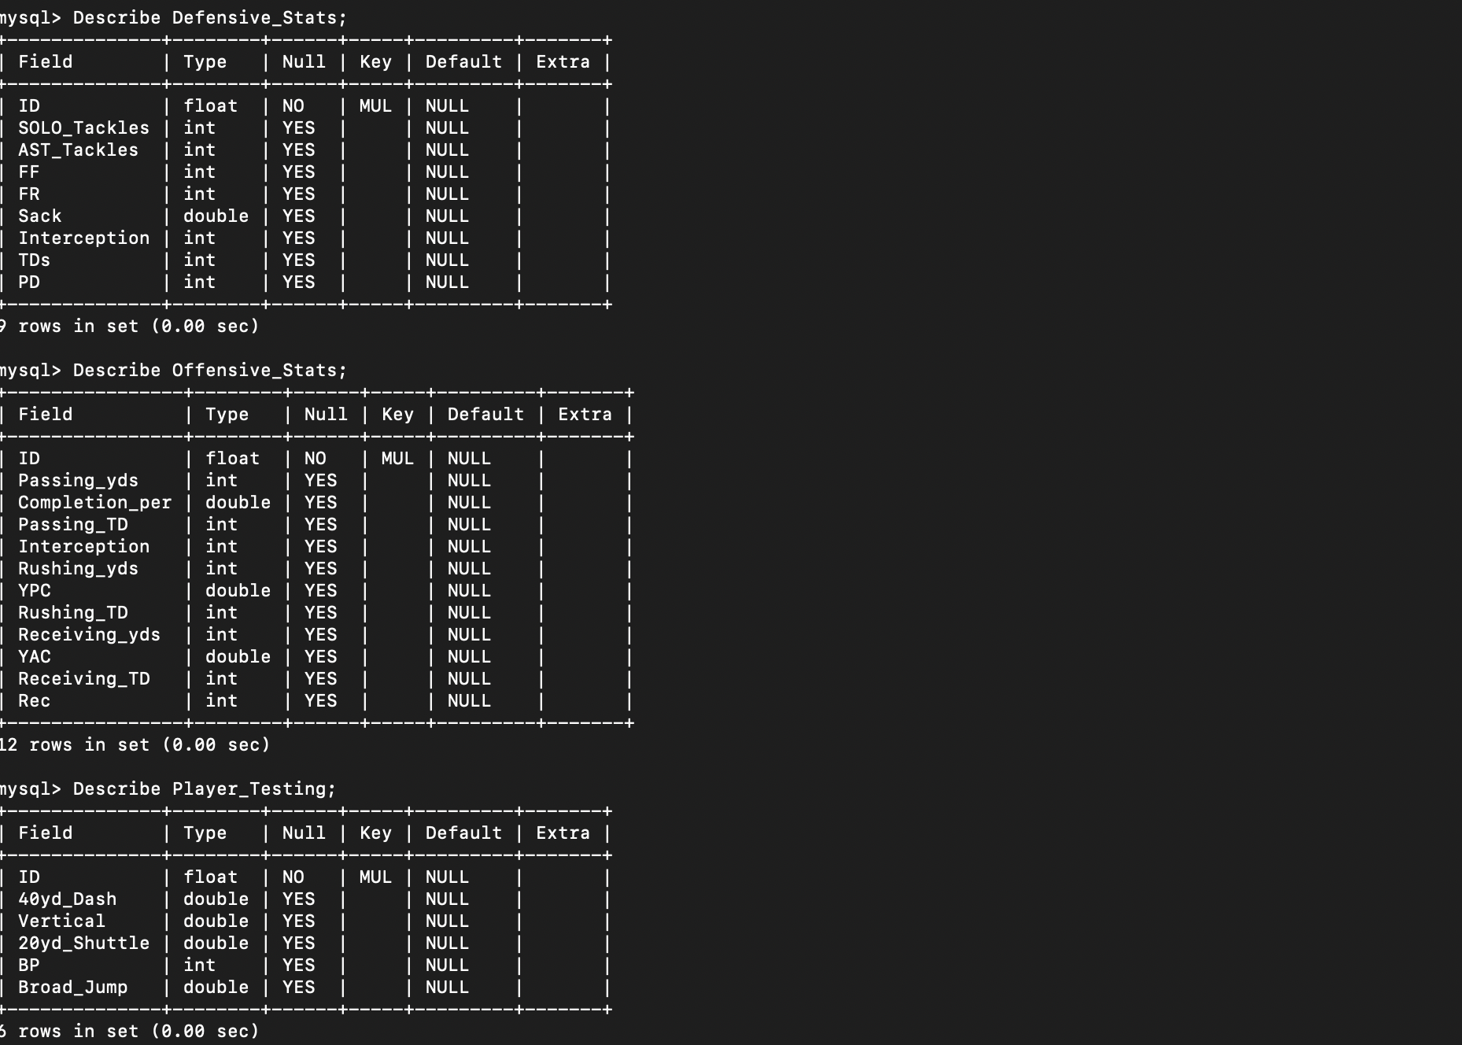
Table Info
Describe table name;
Create Table (Field name, type);
Alter Table tablename Foreign Key (ID) References Players Info(Player ID) ;

Slide 7
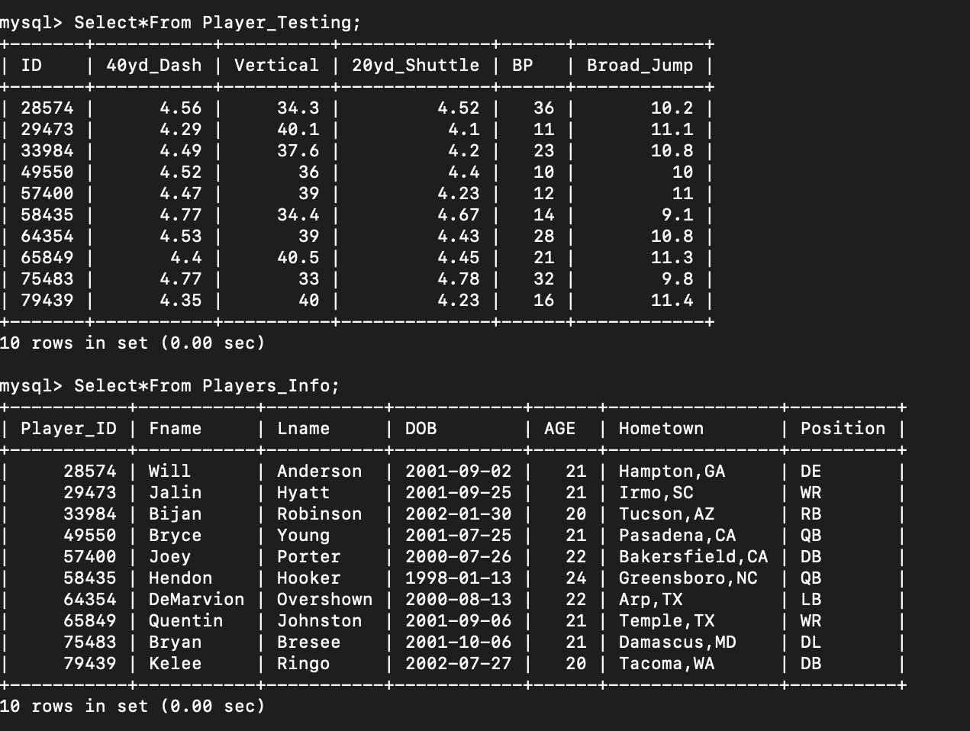
Table Values
Insert Into table name Values (…., …., ….) ;
select*from table name ;

Slide 8
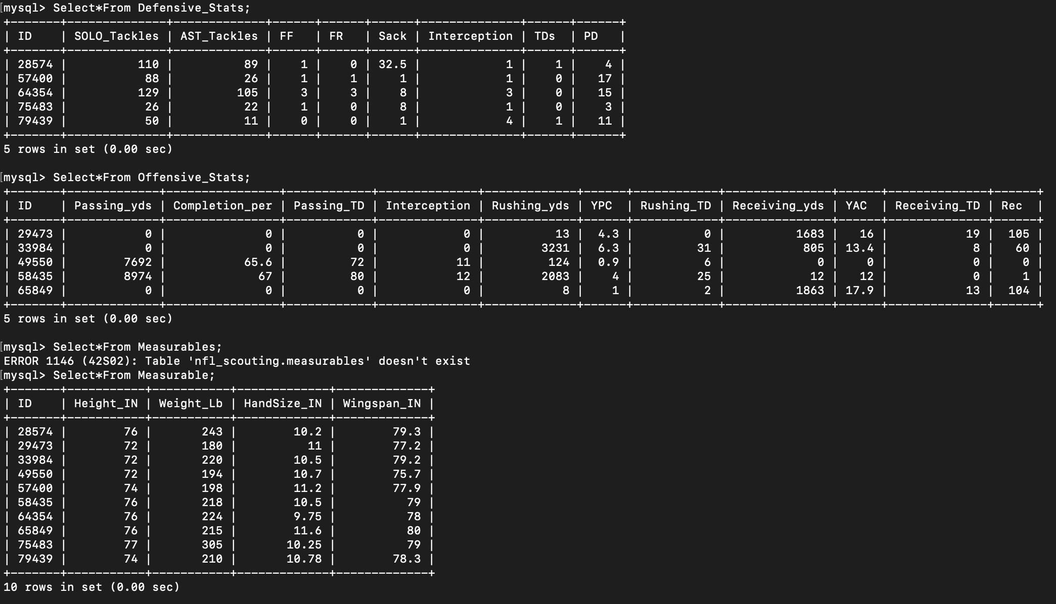
Table Values
Insert Into table name Values (…., …., ….) ;
select*from table name ;

Slide 9
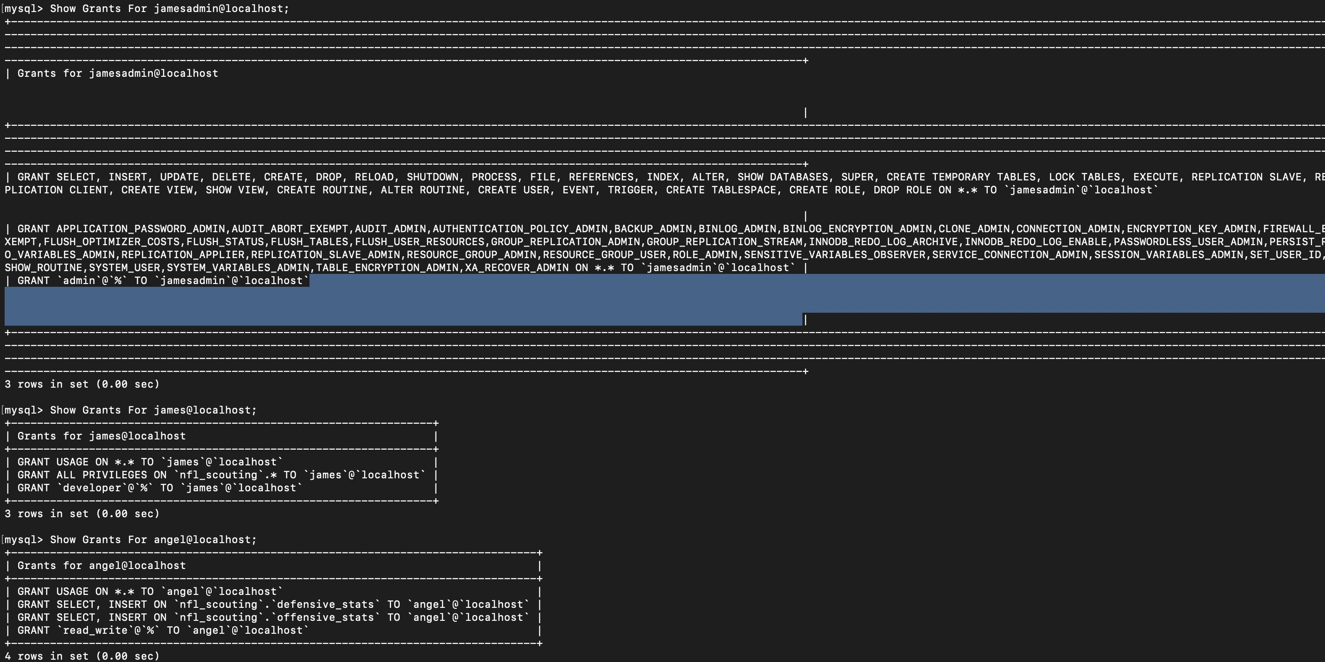
Roles and Privileges
Create Role ( admin, developer, read_write) ;
Create user name@localhost Identified by password ;
Grant rolename TO name@localhost ;
Grant ‘Privileges’ ON database name.tablename To name@localhost ;

Slide 10
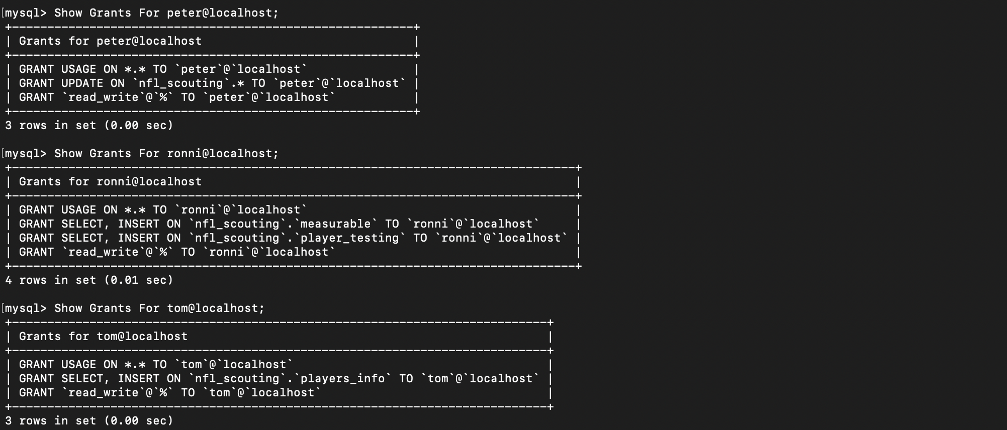
Roles and privilieges
Create Role ( admin, developer, read_write) ;
Create user name@localhost Identified by password ;
Grant rolename TO name@localhost ;
Grant ‘Privileges’ ON database name.tablename To name@localhost ;

Slide 11
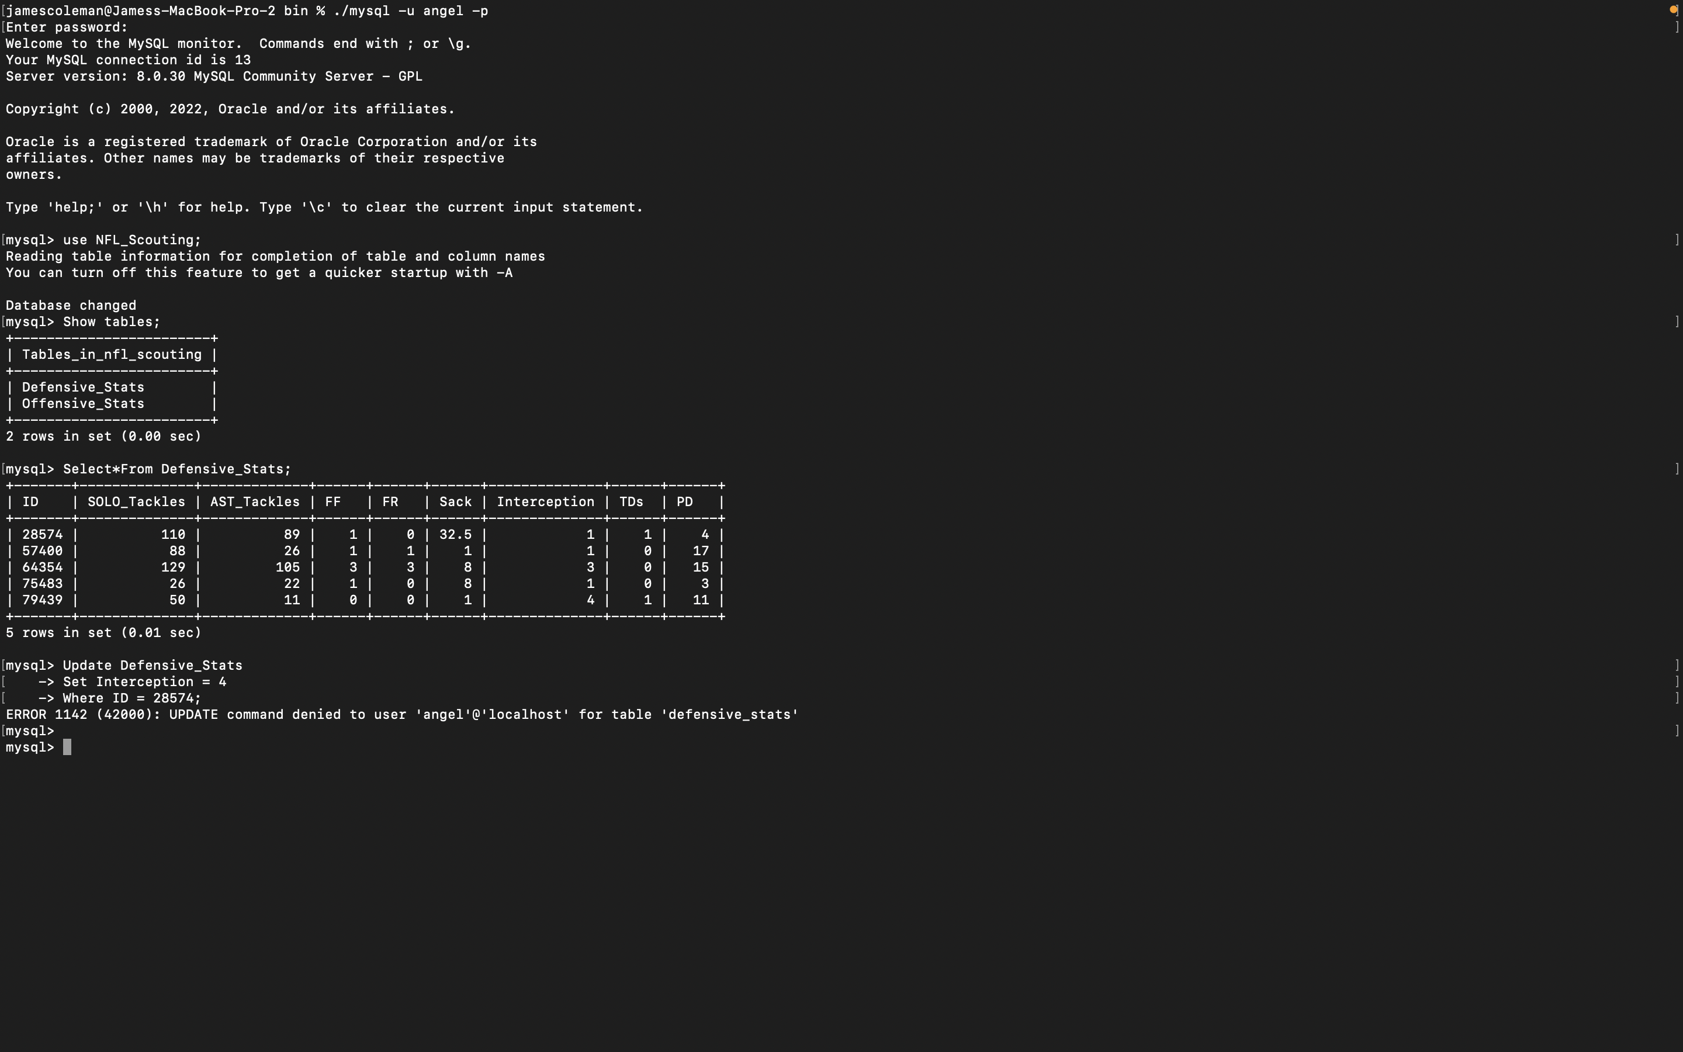

Slide 12
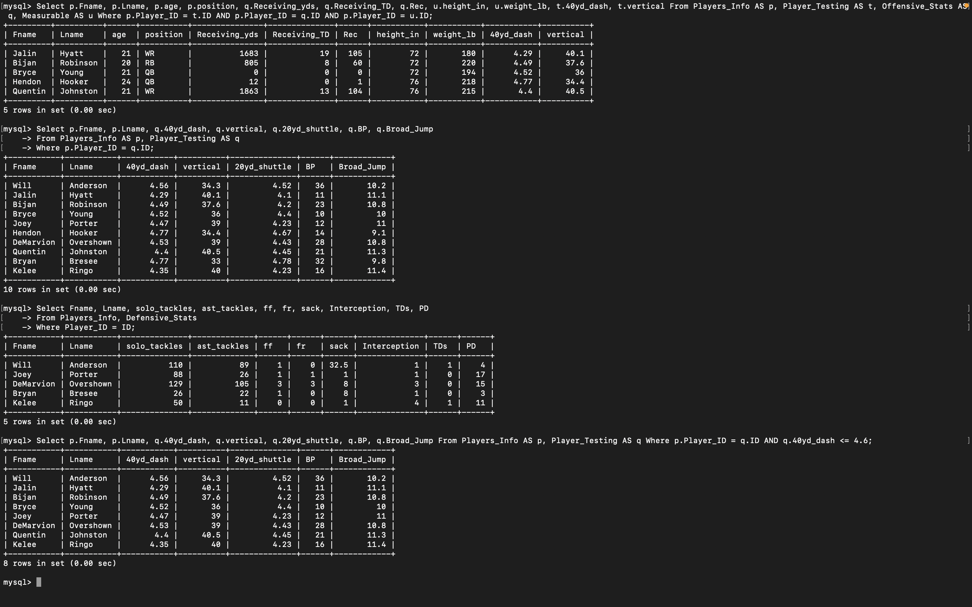

Slide 13
Stop SQL INJECTION
Honeypot environment
Bond Parameters
Diligent monitoring
Restricting and segregating privileges

